Slide 1



WEB/JEE Programming Projet:
Tech-Gadgets Recommandation Platform
Guided by:
Mr. EL HAMLAOUI MAHMOUD
Presented by:
ELBATOURI Badr-eddine
ELGHABI Taha
Data Engineering- DE
School year : 2021/2022

Slide 2

Table of Content
Introduction
General Context
Problem
Idea
Functional requirements
non Functional requirements
Planning
Frontend
Argon Design system
Frontend Conception
Backend
Authentification
Security
Architecture
Machine Learning
Data preparation
Text Pre-processing
Model Construction
Demo
Conclusion
‹#›

Slide 3
1
Introduction
‹#›
Notes:
Amine

Slide 4

Intro
‹#›

Slide 5
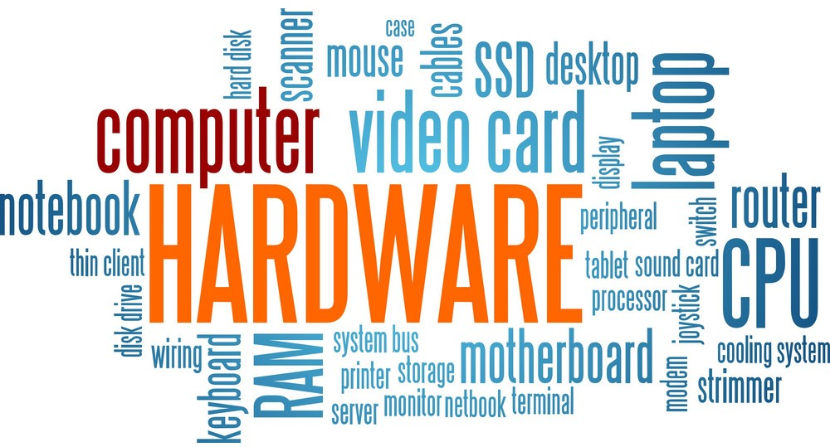
Intro
‹#›

Slide 6
2
General Context
Idea, Needs, objectives ...
‹#›

Slide 7
Problem and Idea
Several people are in need of tech devices and gadgets
But they have little to no technical knowledge.
Create a web app that recommends Tech-Gadgets!
‹#›

Slide 8
Functional requirements
User
Guest
Authentification
Description of a Tech-Gadget
Description of a Tech-Gadget
Obtain a list of products
Evaluate Results
Obtain a list of products
‹#›

Slide 9
Non Functional requirements
1- User experience
3- User adaptable
2- Progressive learning
4- Confidentiality
‹#›

Slide 10
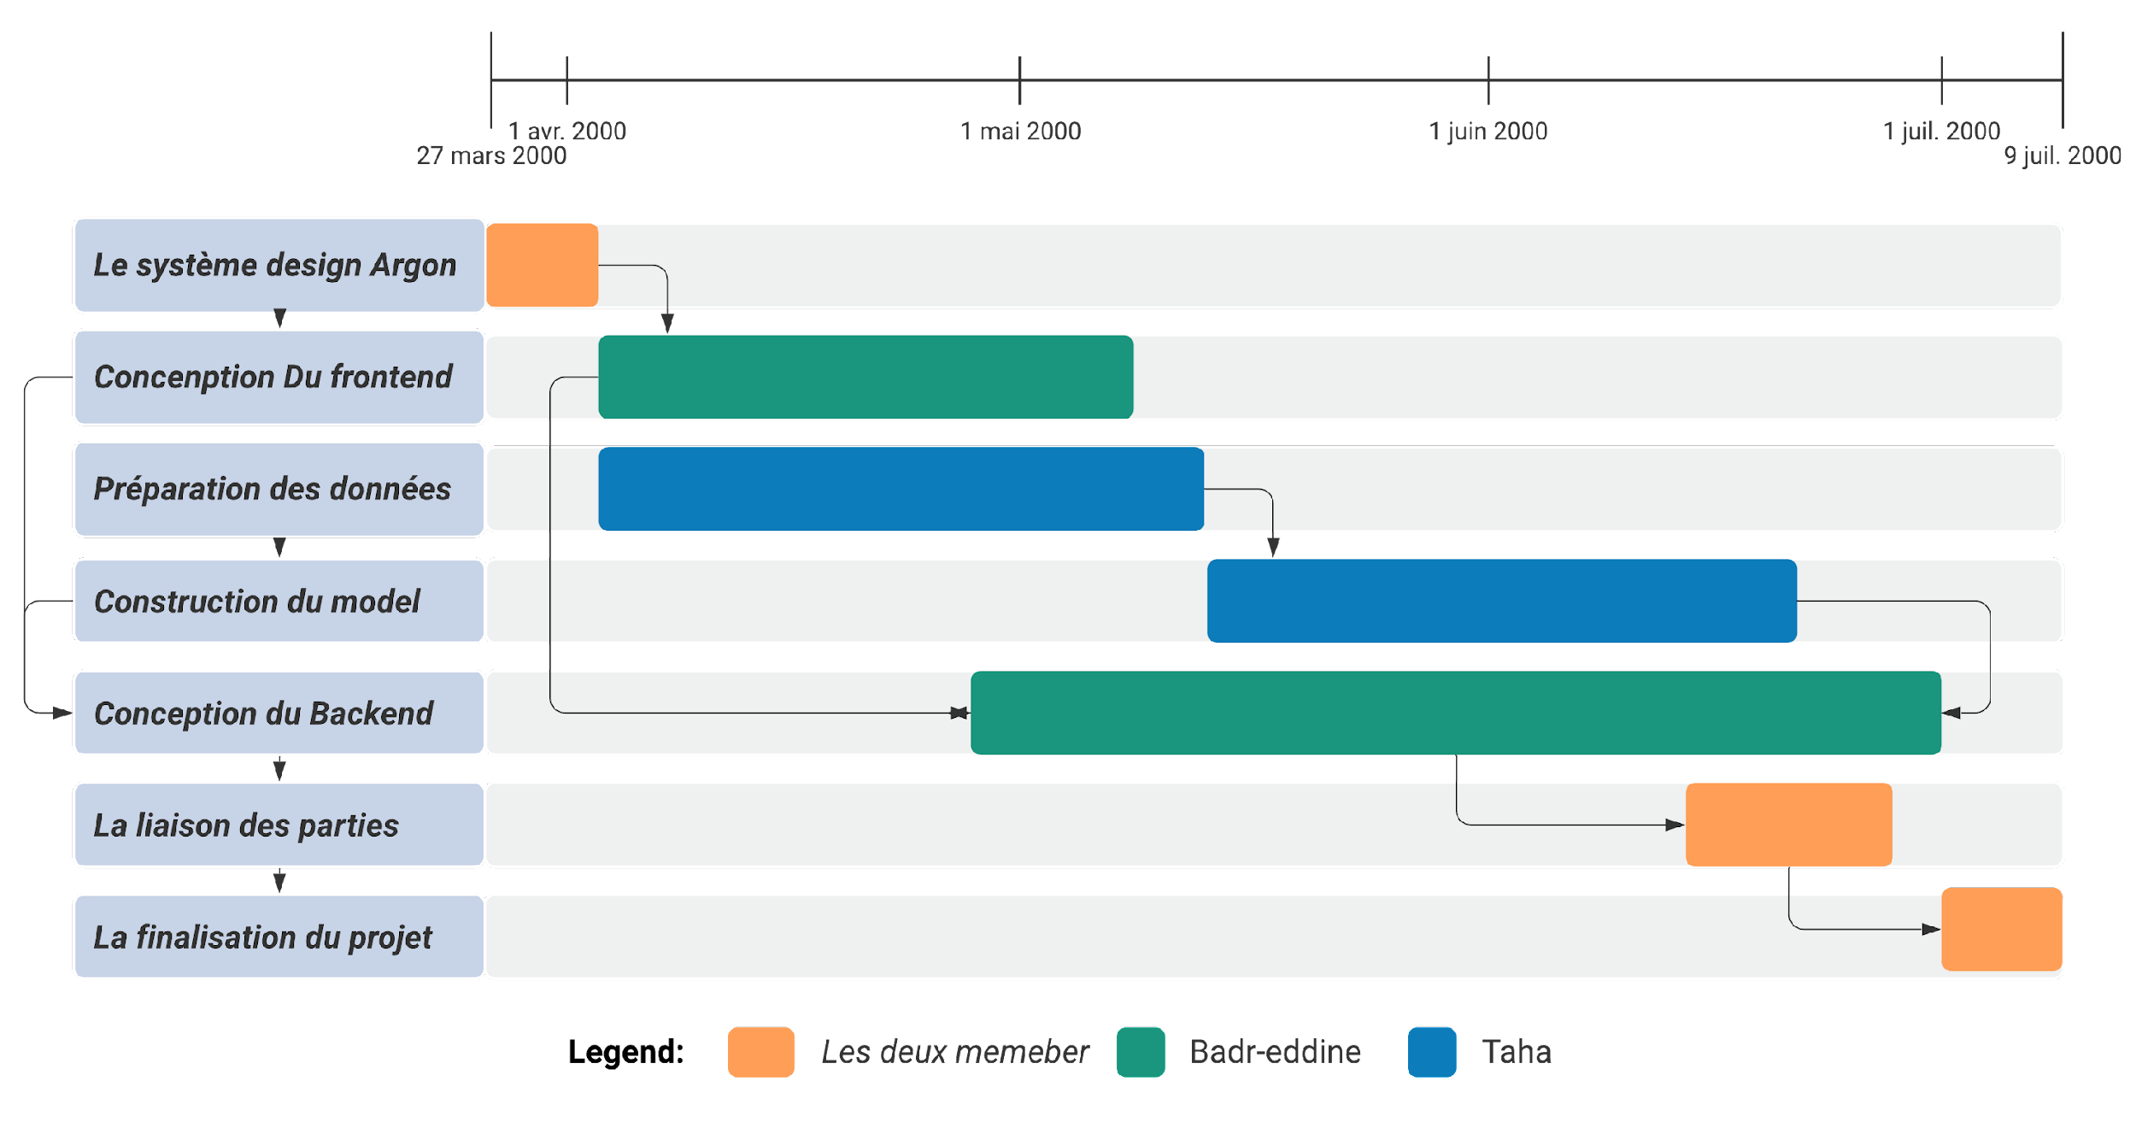
Planning
‹#›

Slide 11
3
Frontend
Development Tools, Interfaces ...
‹#›

Slide 12
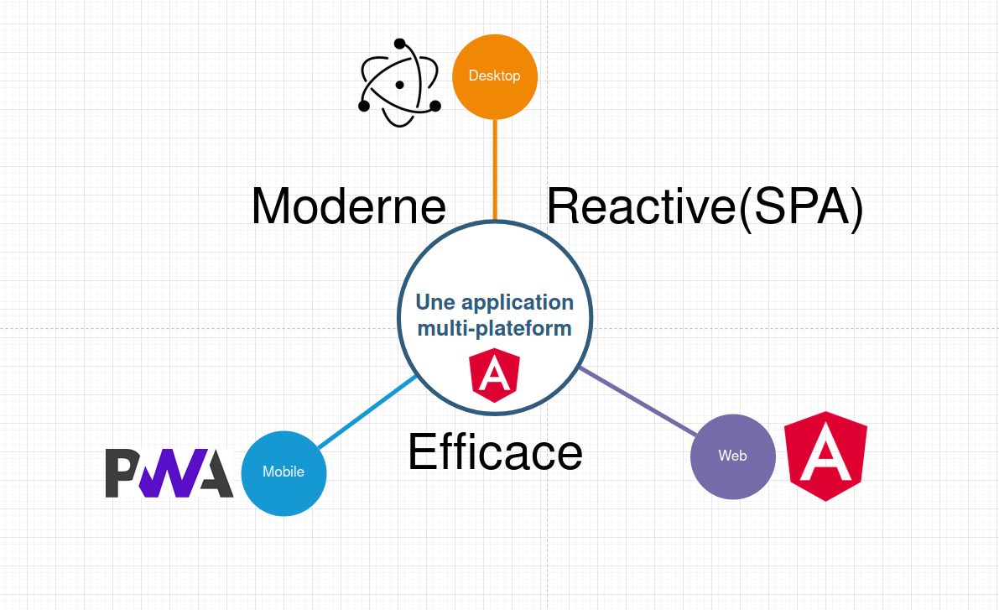
Frontend Technologies
Problem, solution and Tech-stack choice
‹#›

Slide 13
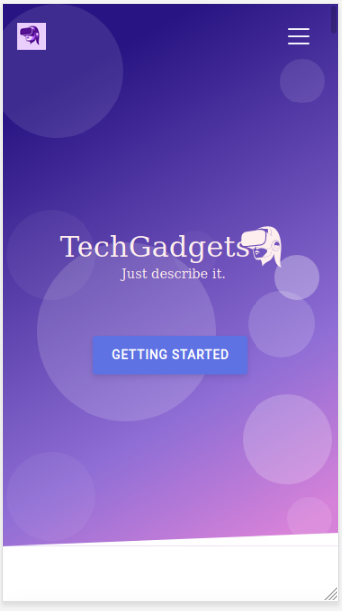
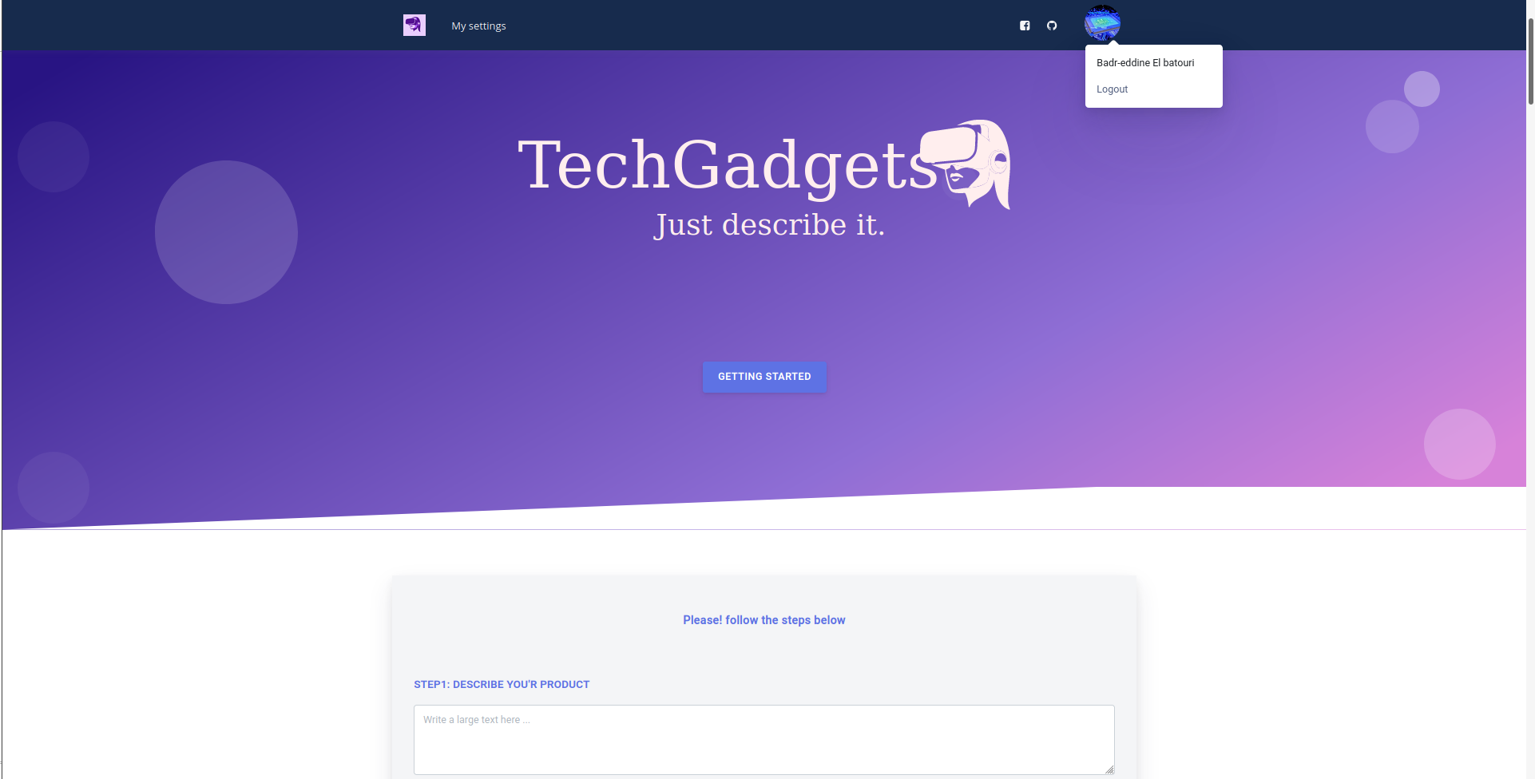
Responsive Platform
Significante Logo and Colors.
‹#›
Analyse de Résultats Front-End : User experience

Slide 14
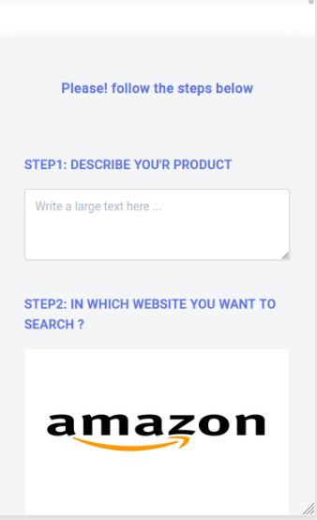
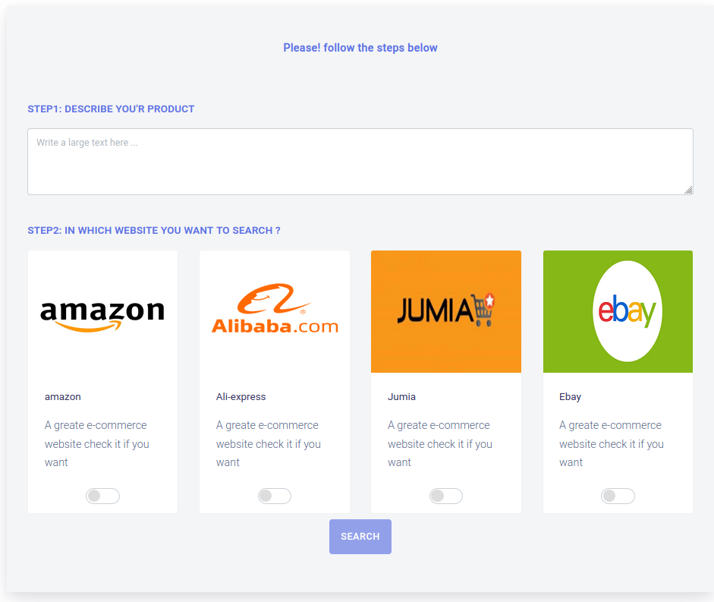
User Interface ( Main dashboard )
‹#›

Slide 15
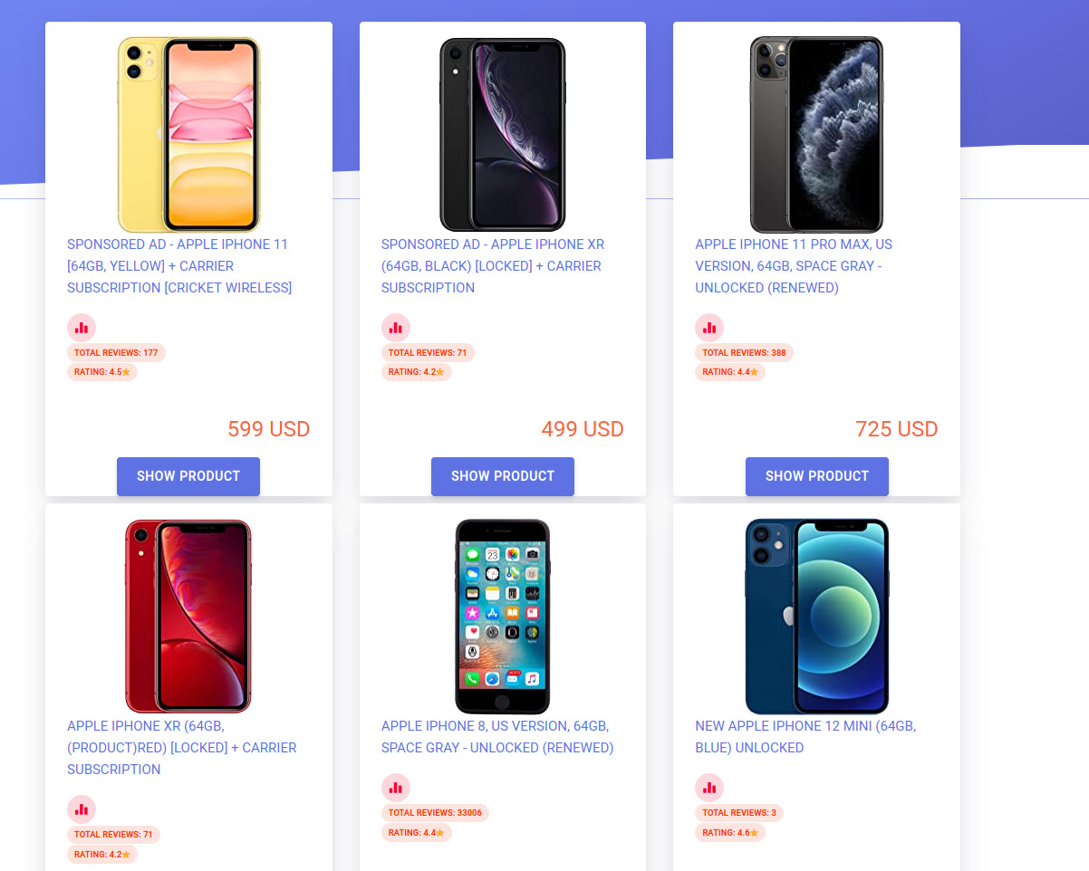
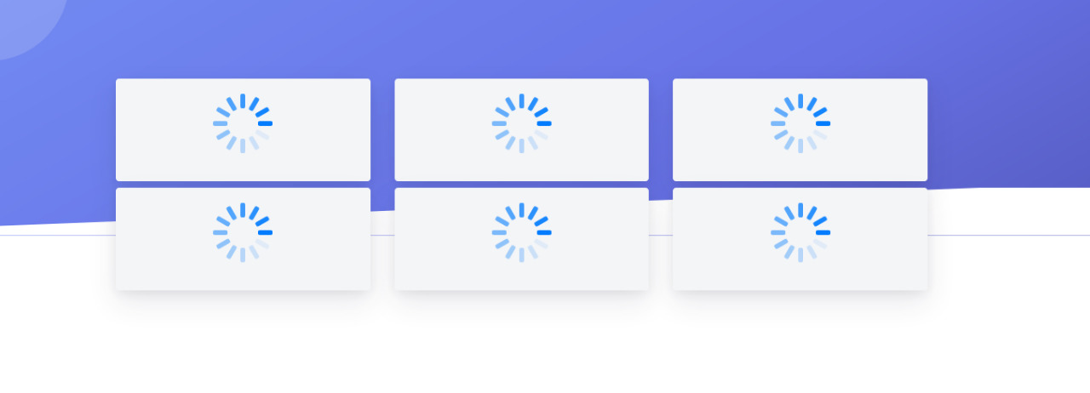
User Experience
UI indicators to guide the user
‹#›

Slide 16
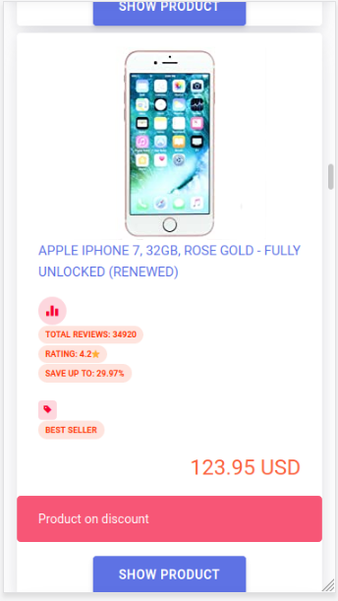
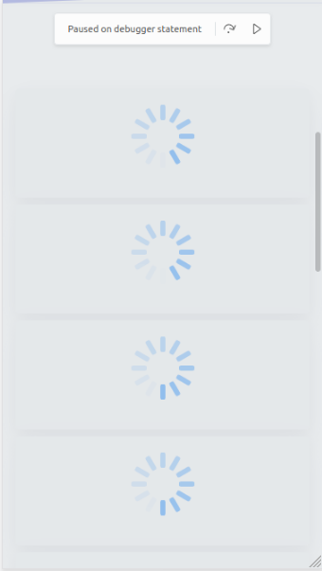
User Experience ( Mobile )
Indicateurs UI pour guider l’utilisateur(Mobile)
‹#›

Slide 17
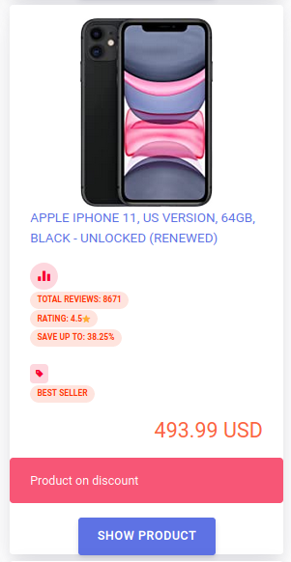
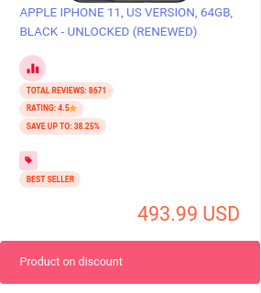
User Interface ( tags )
‹#›

Slide 18
4
Backend
Development Tools, Architecture...
‹#›

Slide 19
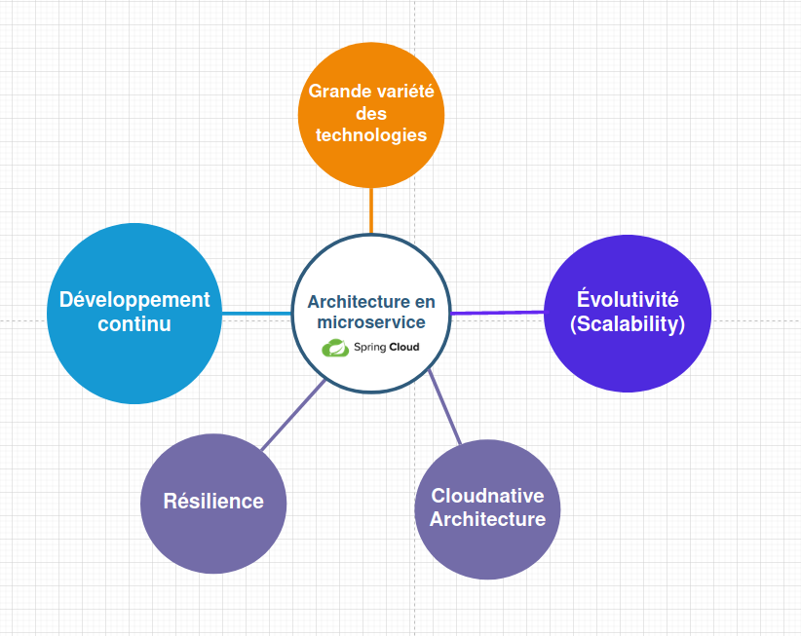
Backend Architecture
‹#›

Slide 20
5
Machine Learning
Data Preparation, NLP …
‹#›

Slide 21
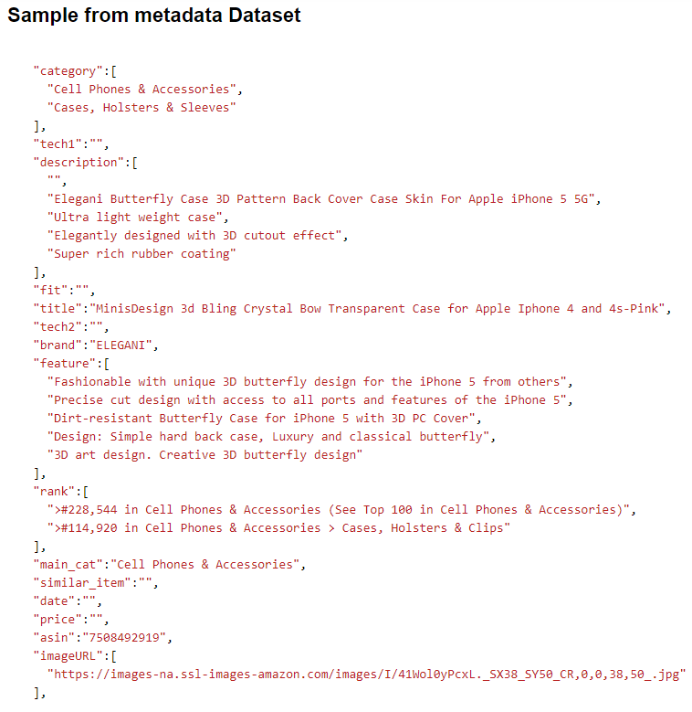
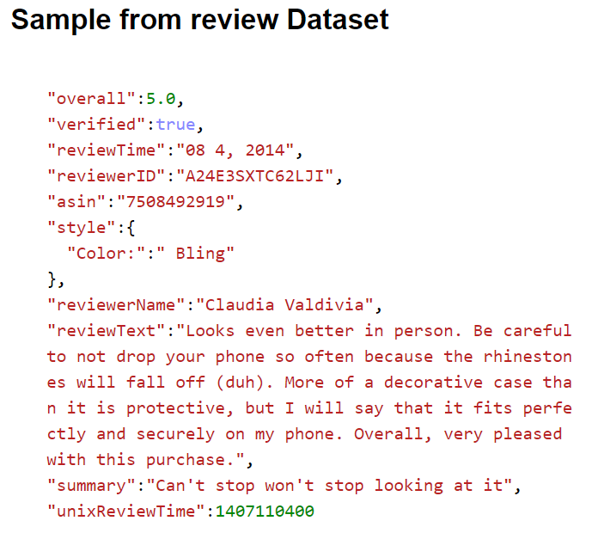
Discovering our Data
Dataset source
‹#›

Slide 22
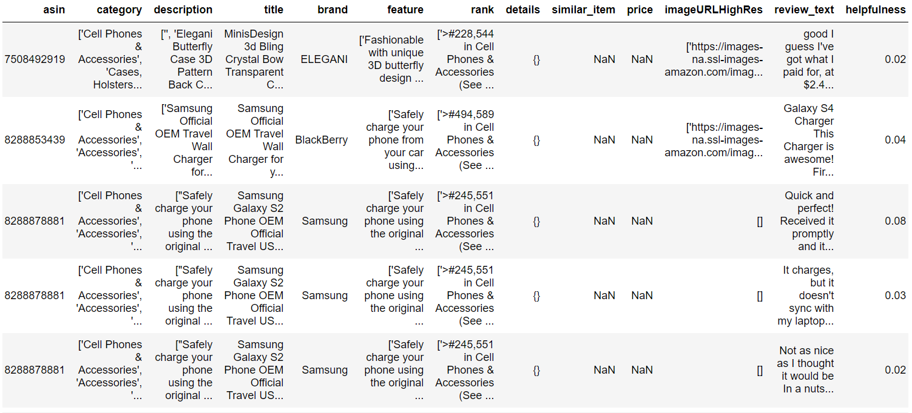
Data Preparation
Dataset Cleaning
‹#›

Slide 23
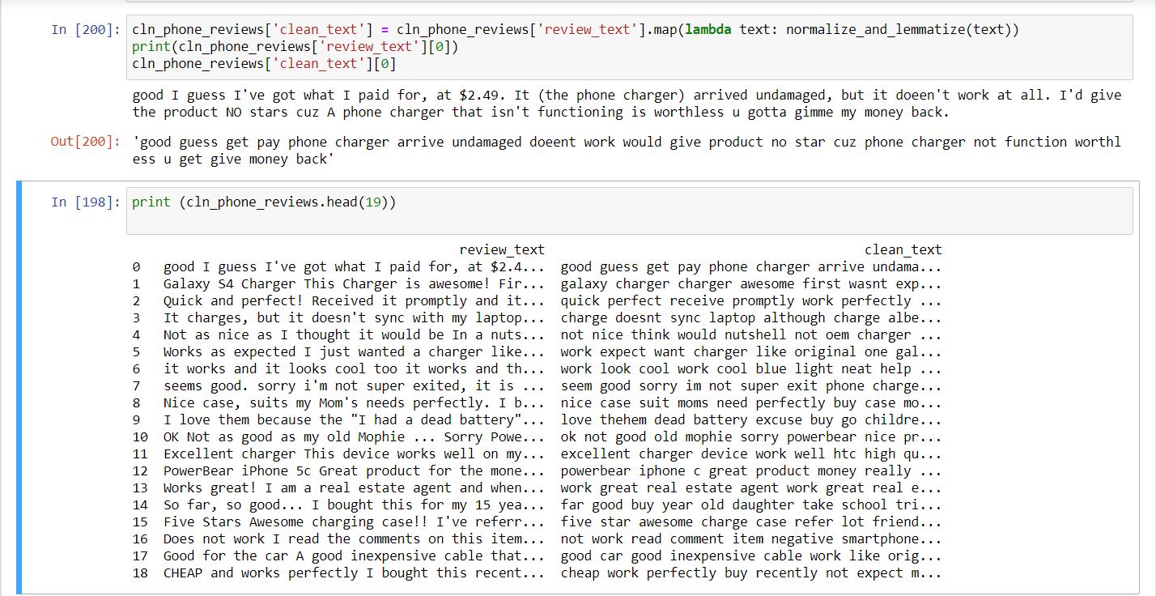
Text Preprocessing
‹#›

Slide 24
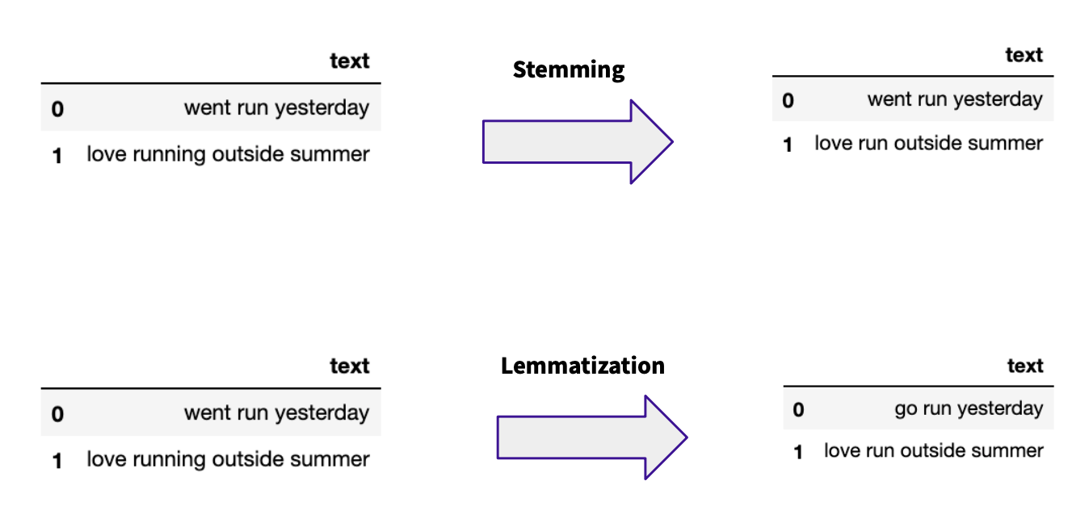
Text Preprocessing
‹#›

Slide 25
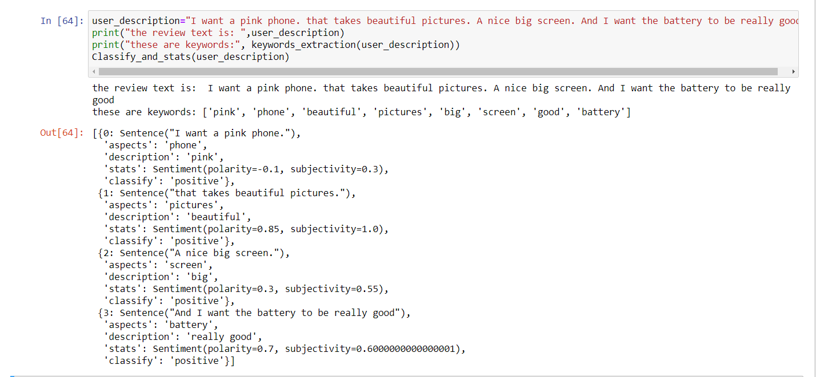
Aspect Based Sentimental Analysis
‹#›

Slide 26
Model Construction
1. Feature Engineering and Selection
(Words2Vec)
(Splitting Dataset into Train and Test Set)
2. Data Preprocessing
3. Selecting the Right Evaluation Metric
4. Modelling
‹#›

Slide 27
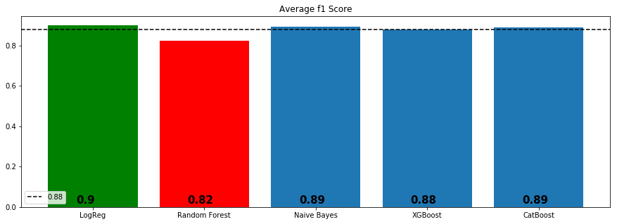
Model Construction
Models with CountVectorizer Bag of Words
‹#›

Slide 28





Development tools
‹#›

Slide 29

6
Demo
‹#›

Slide 30

7
Conclusion
‹#›

Slide 31
Thanks for your attention!
‹#›

